Slide 1
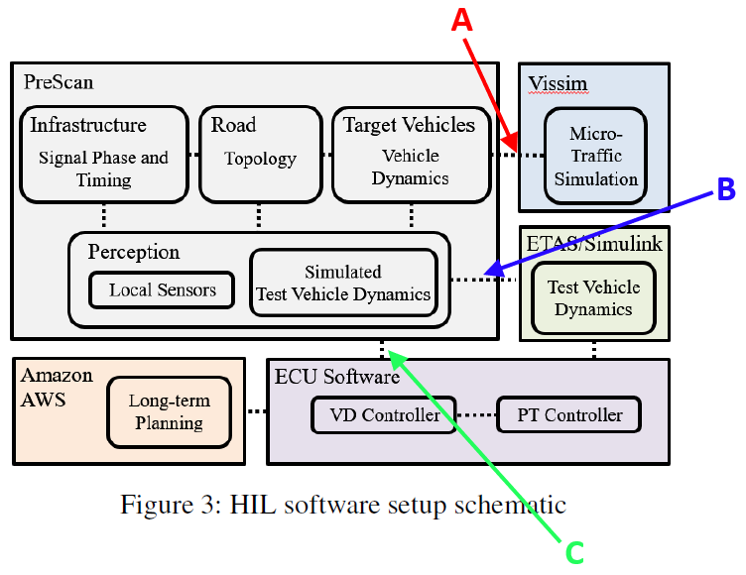

Signal A:
PreScan sends ego vehicle information (velocity) to VISSIM
VISSIM then provides PreScan with all traffic network information (they mirror each other)
Signal B:
Simulink vehicle and powertrain dynamics are mirrored in Prescan
Signal C:
Ego vehicle’s states
Lead vehicle’s states
Distance to upcoming intersections and their SPaT info

